Slide 1

SYSTEM DESIGN

Slide 2





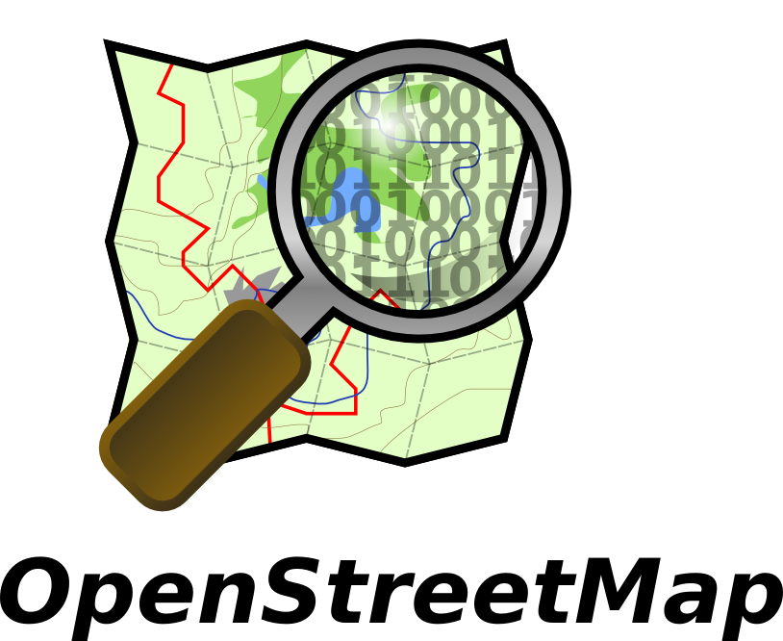





Software Technologies

Slide 3
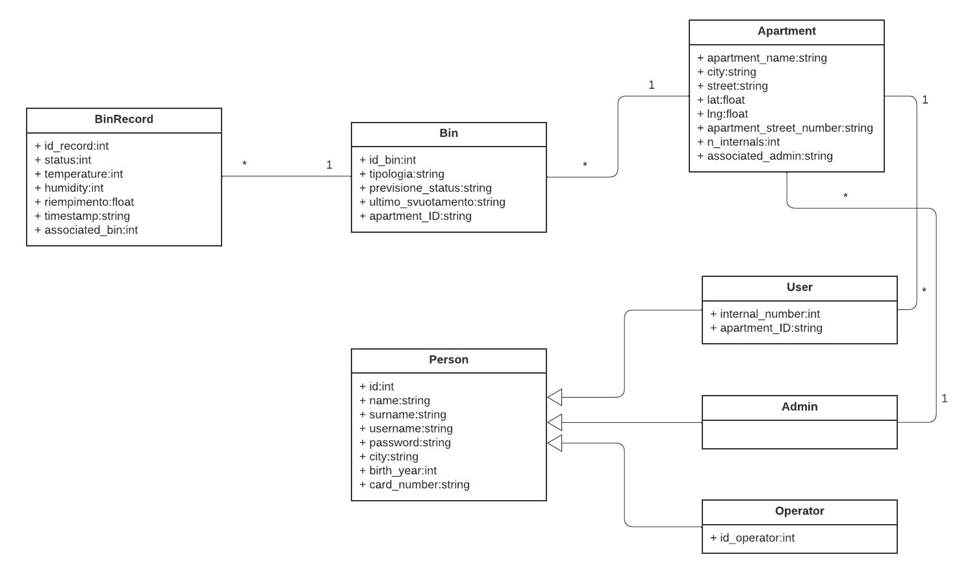
UML Class

Slide 4
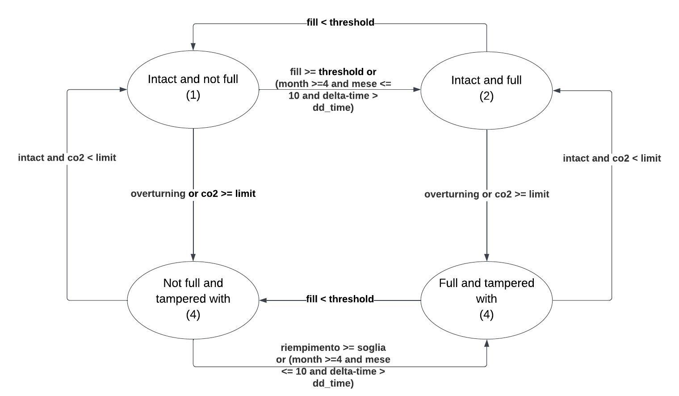
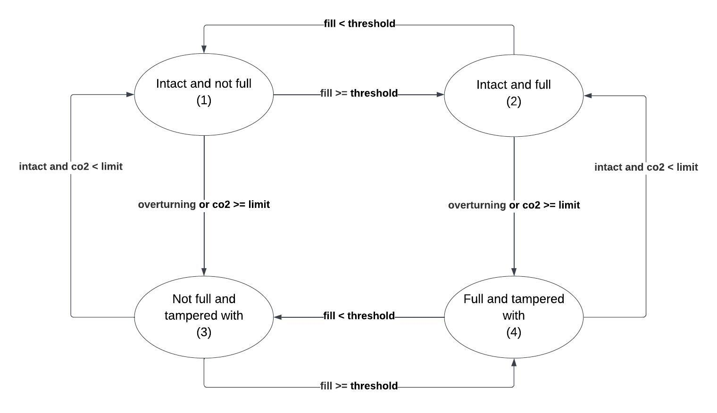

Finite state machine for bin state

Slide 5

Finite state machine for wet bin state
delta_time = interval of days since the last emptying
dd_time = number of days that can elapse since the last emptying. Depending on the temperature it is five days for average temperatures, 3 for high temperatures and 2 for very high temperatures.

Slide 6
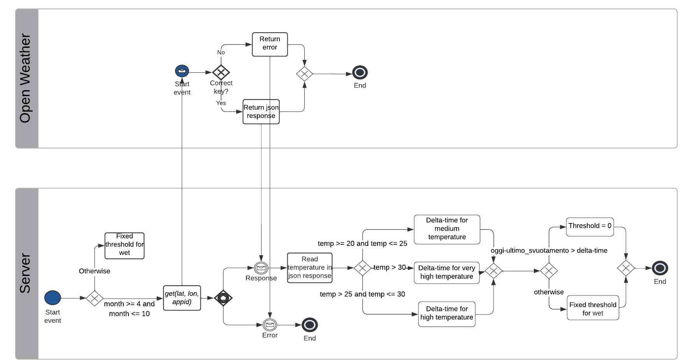
Get organic threshold

Slide 7
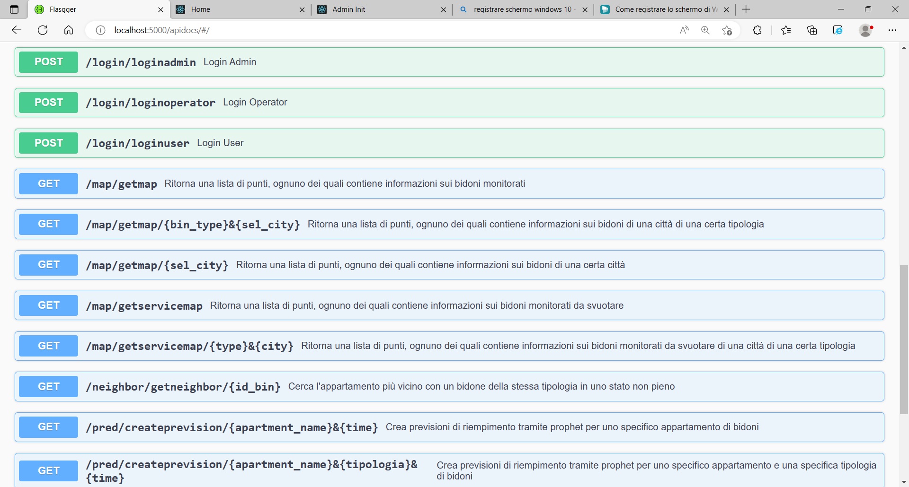
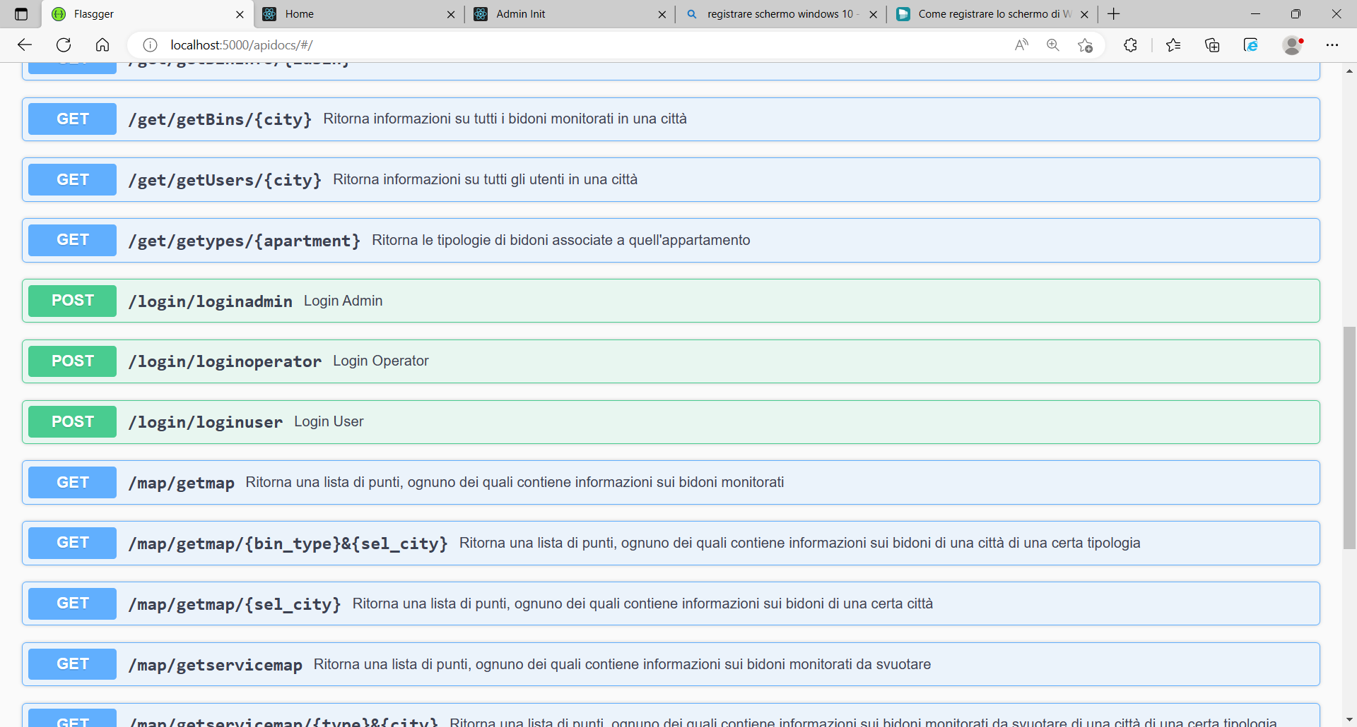
API map

Slide 8
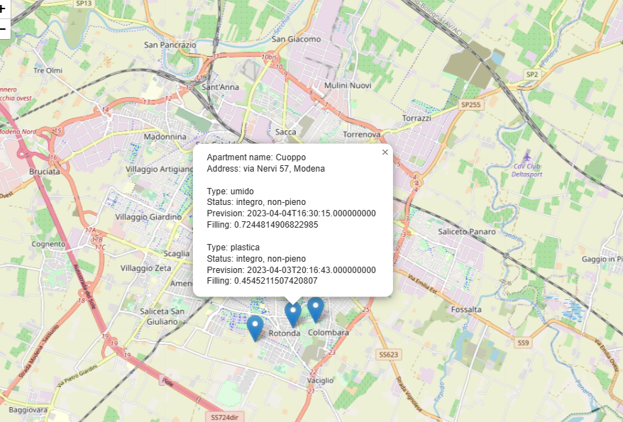
Map with all bins

Slide 9
Map with bins of a certain typology

Slide 10
Service map with full bins

Slide 11
Service map with full bins of a certain typology

Slide 12
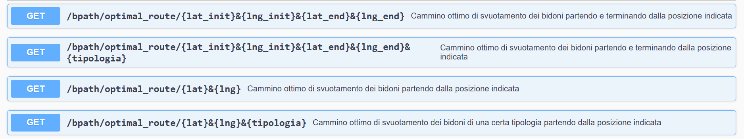
API Best Path

Slide 13
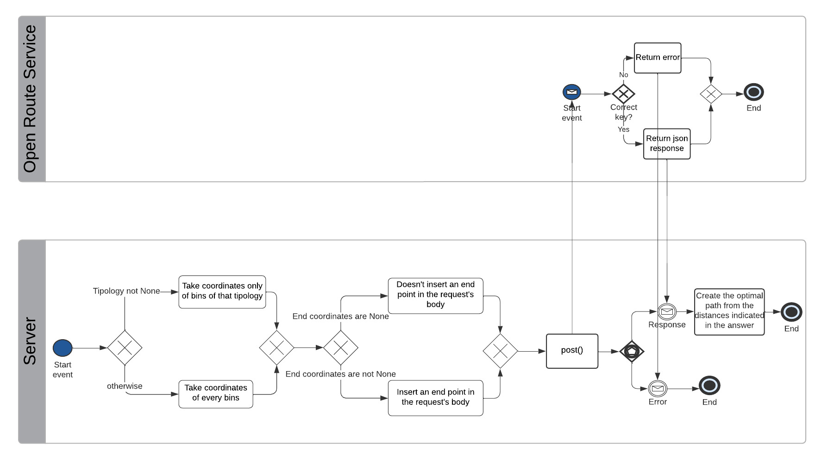
Optimal route

Slide 14
Map with the optimal path of emptying bins

Slide 15
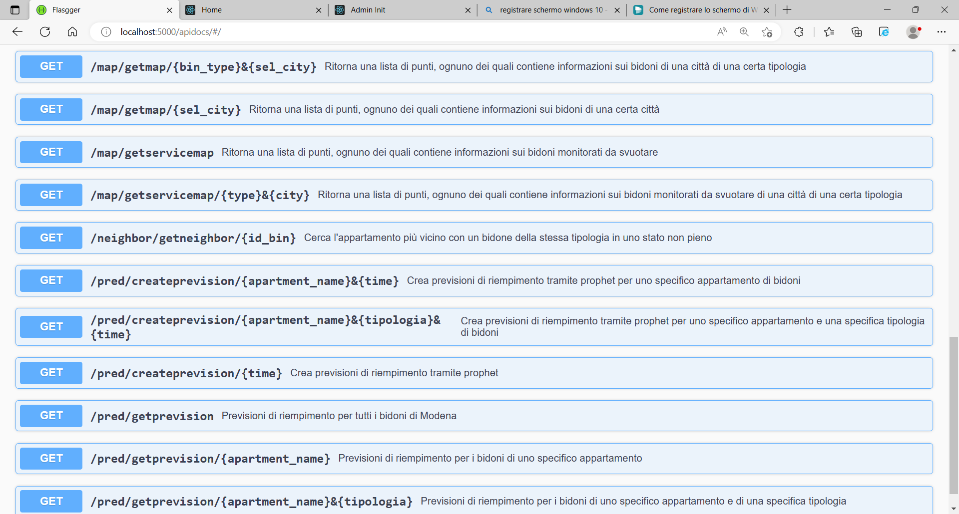
API Neighbor

Slide 16
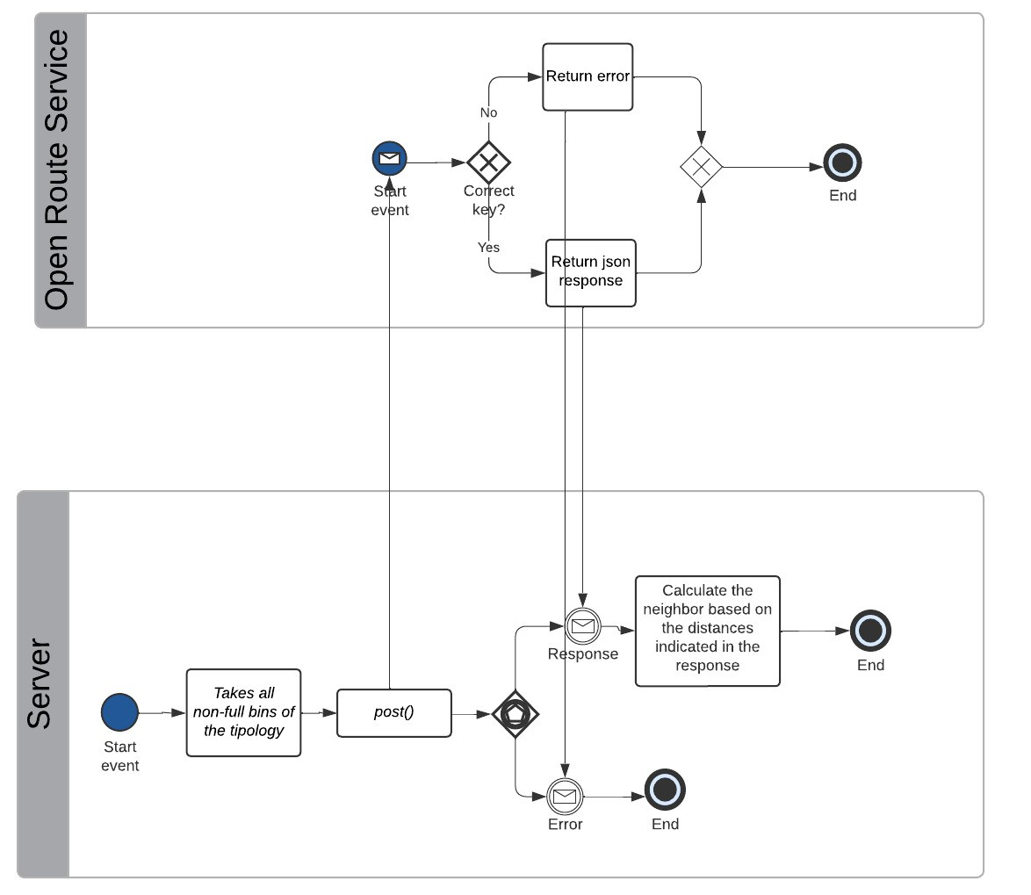
Get neighbor

Slide 17
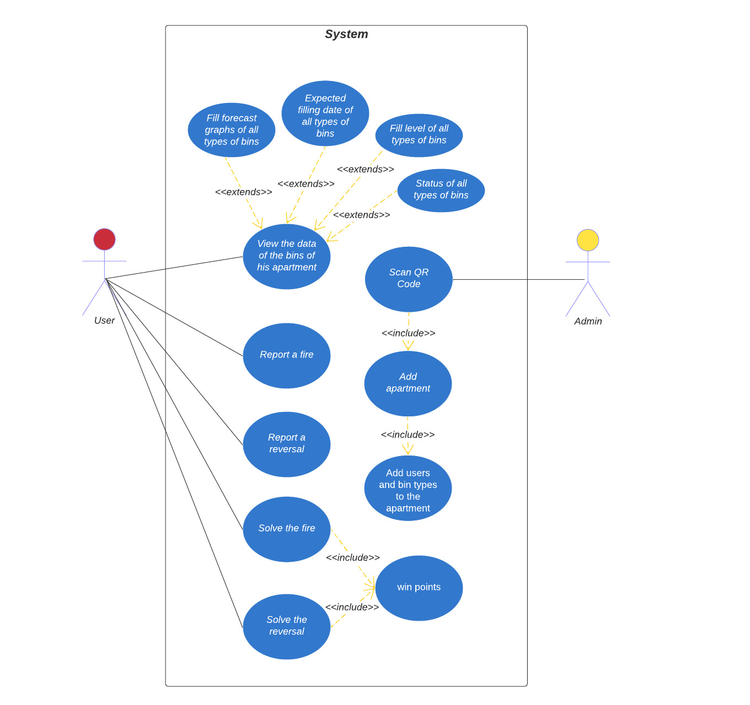
UML Use Case Diagram

Slide 18
API login

Slide 19
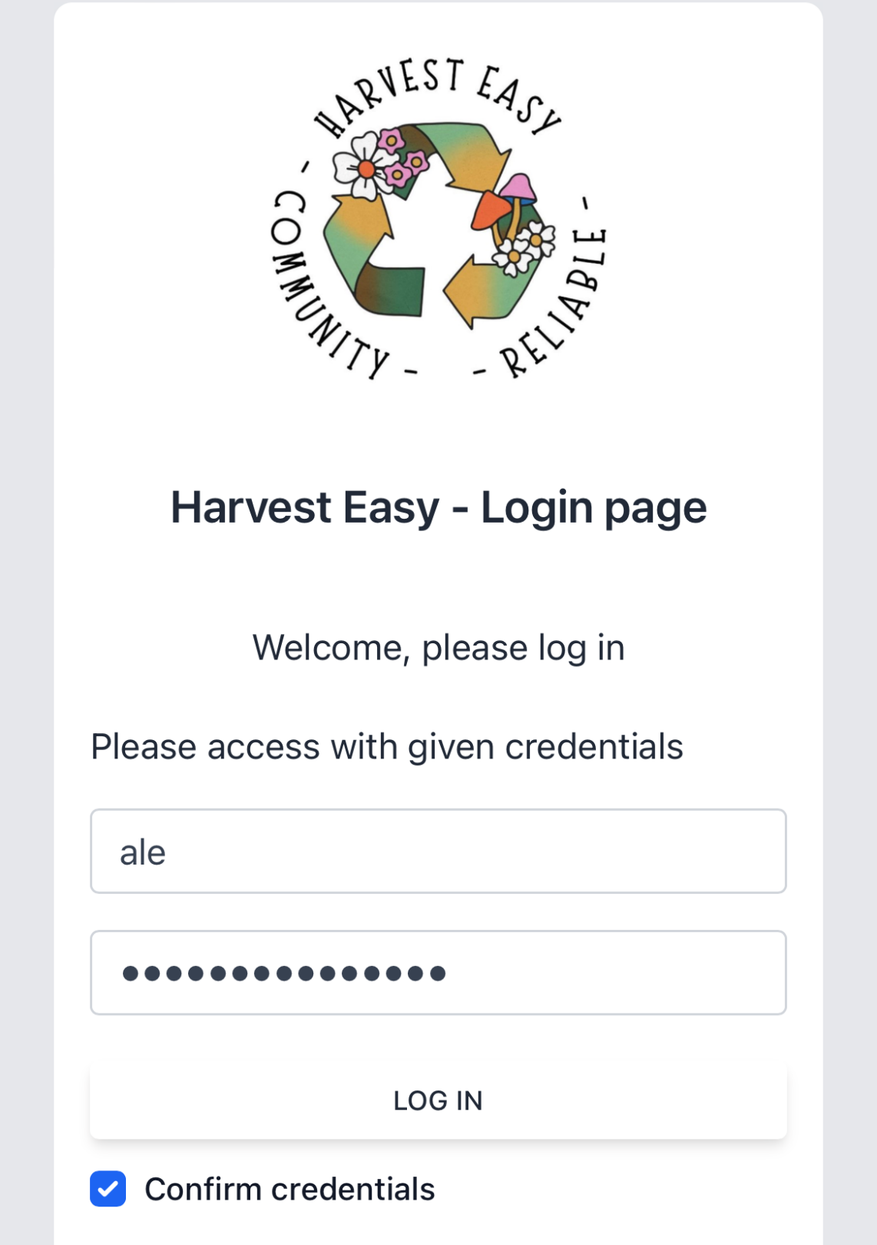
User’s login page

Slide 20
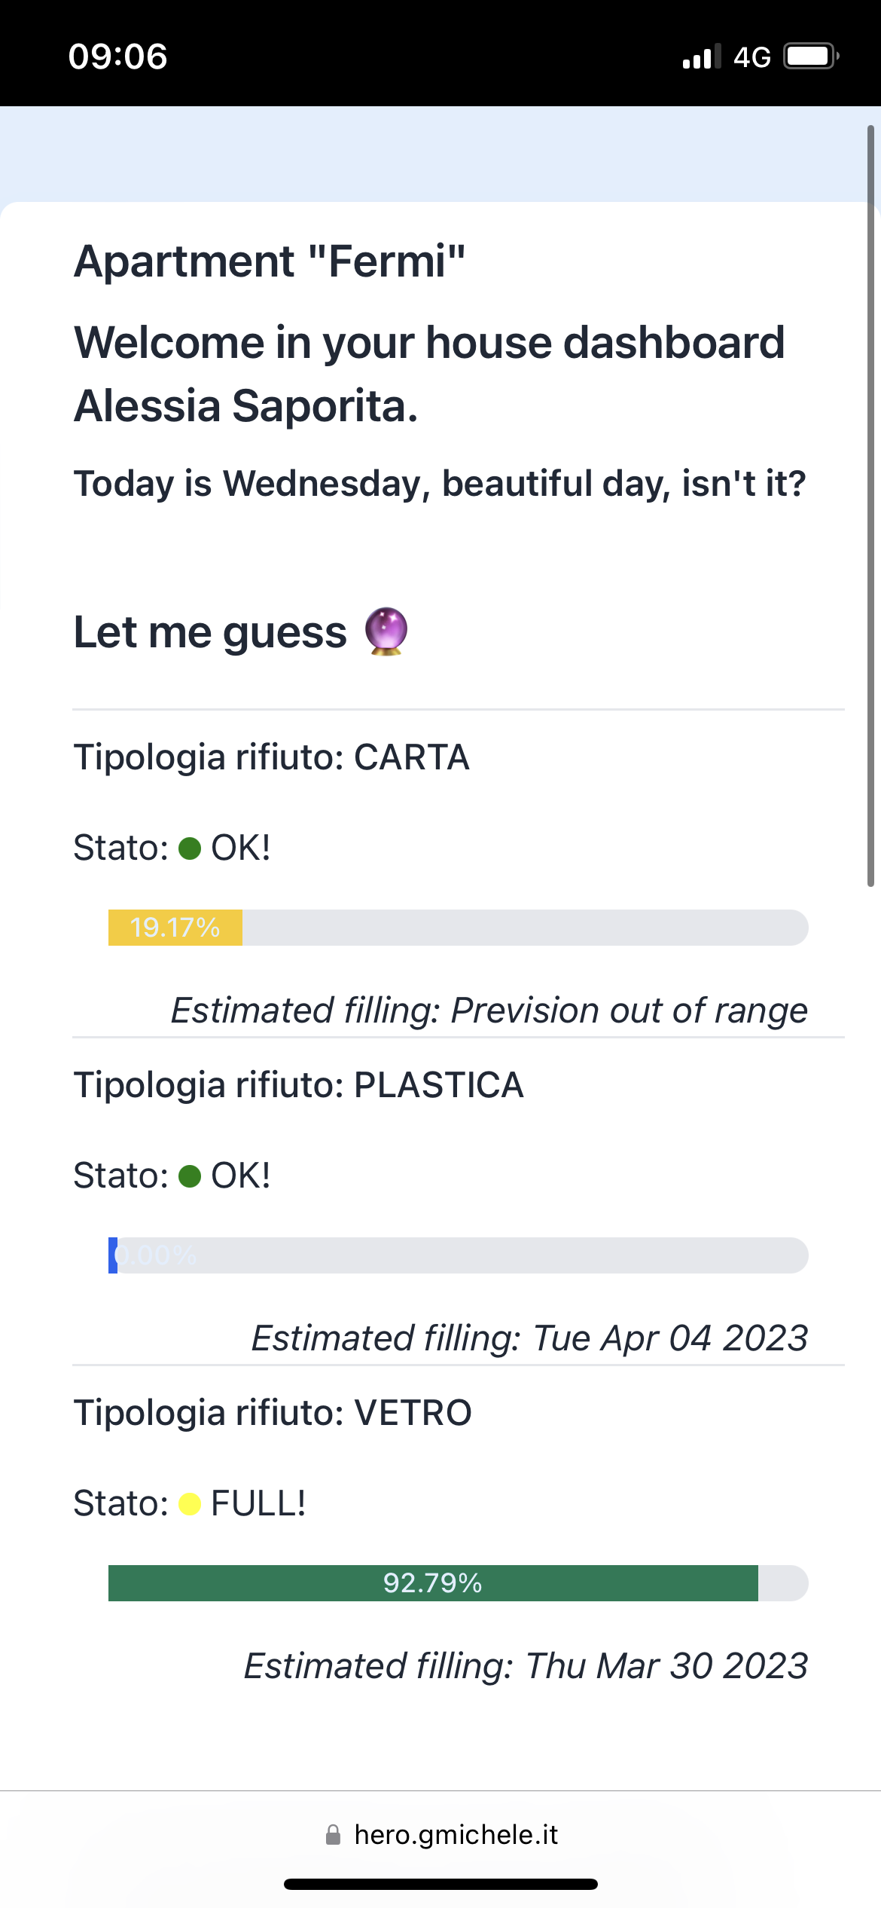
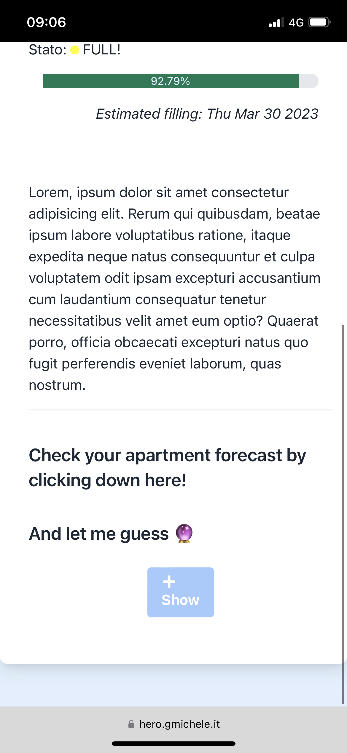
User’s page

Slide 21
Apartment initialization: scan the QR Code

Slide 22
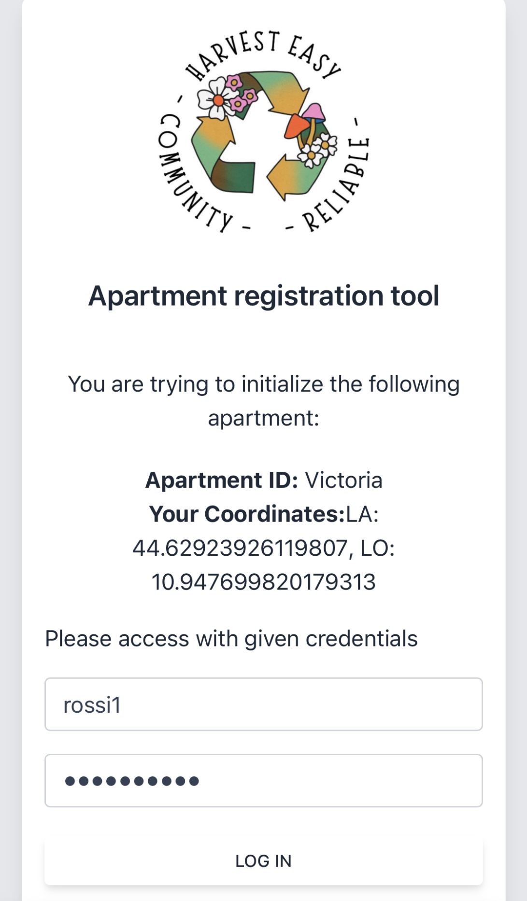
Apartment initialization: admin authentication

Slide 23
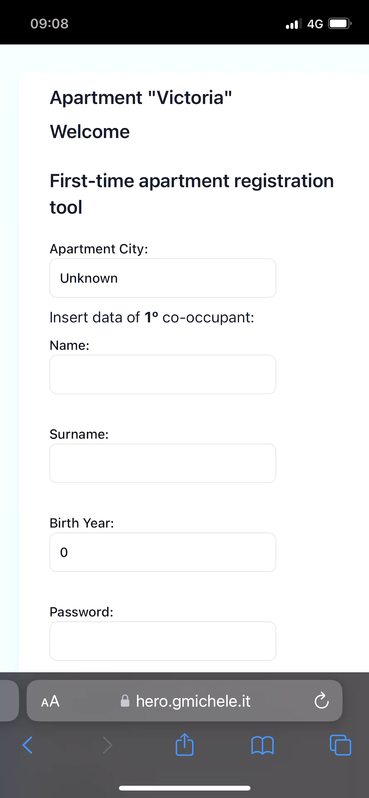
Apartment initialization: registration of apartment data

Slide 24
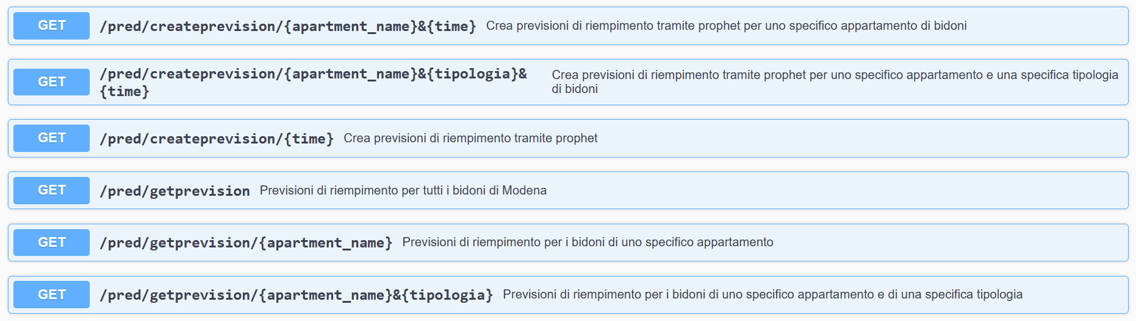
API Prophet

Slide 25
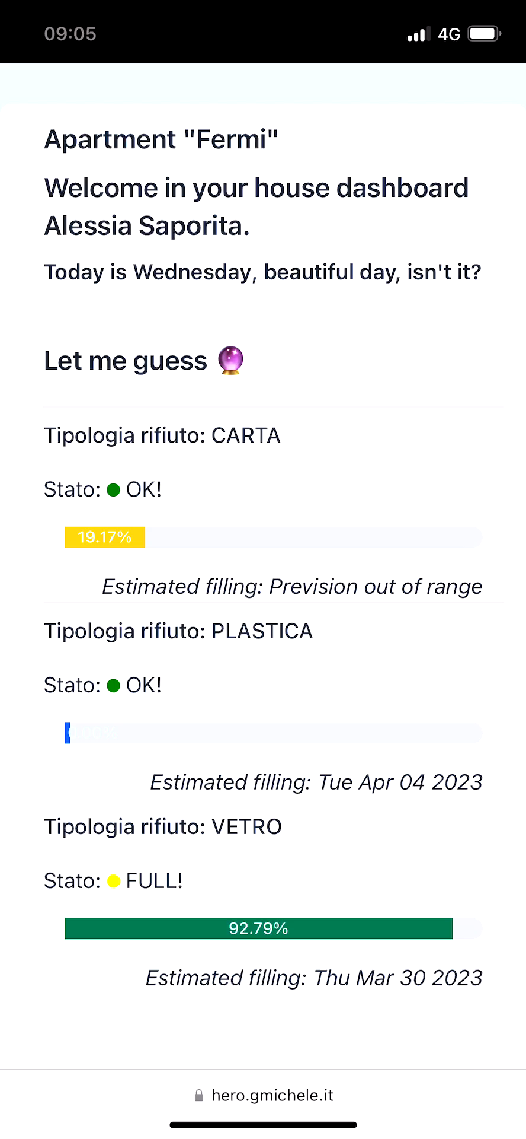
Facebook Prophet: An Algorithm For Time-Series Data

Slide 26
Thanks for your attention! Questions?

Slide 28
Tecnologies
Sensors
Actuators
3-axis gyroscope MPU-6050
CO2 sensor Mq135
Temperature and humidity sensor DHT11
Ultrasonic sensor HC SR04
16x2 I2C LCD display
RFID

Slide 29
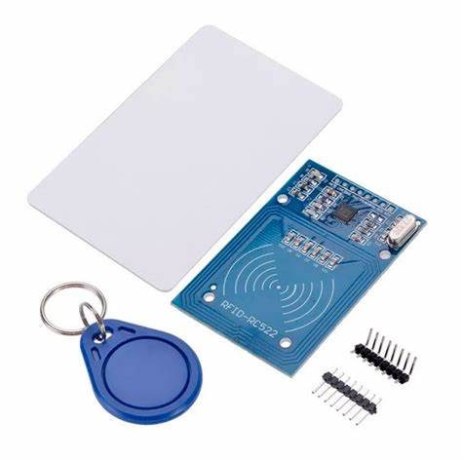
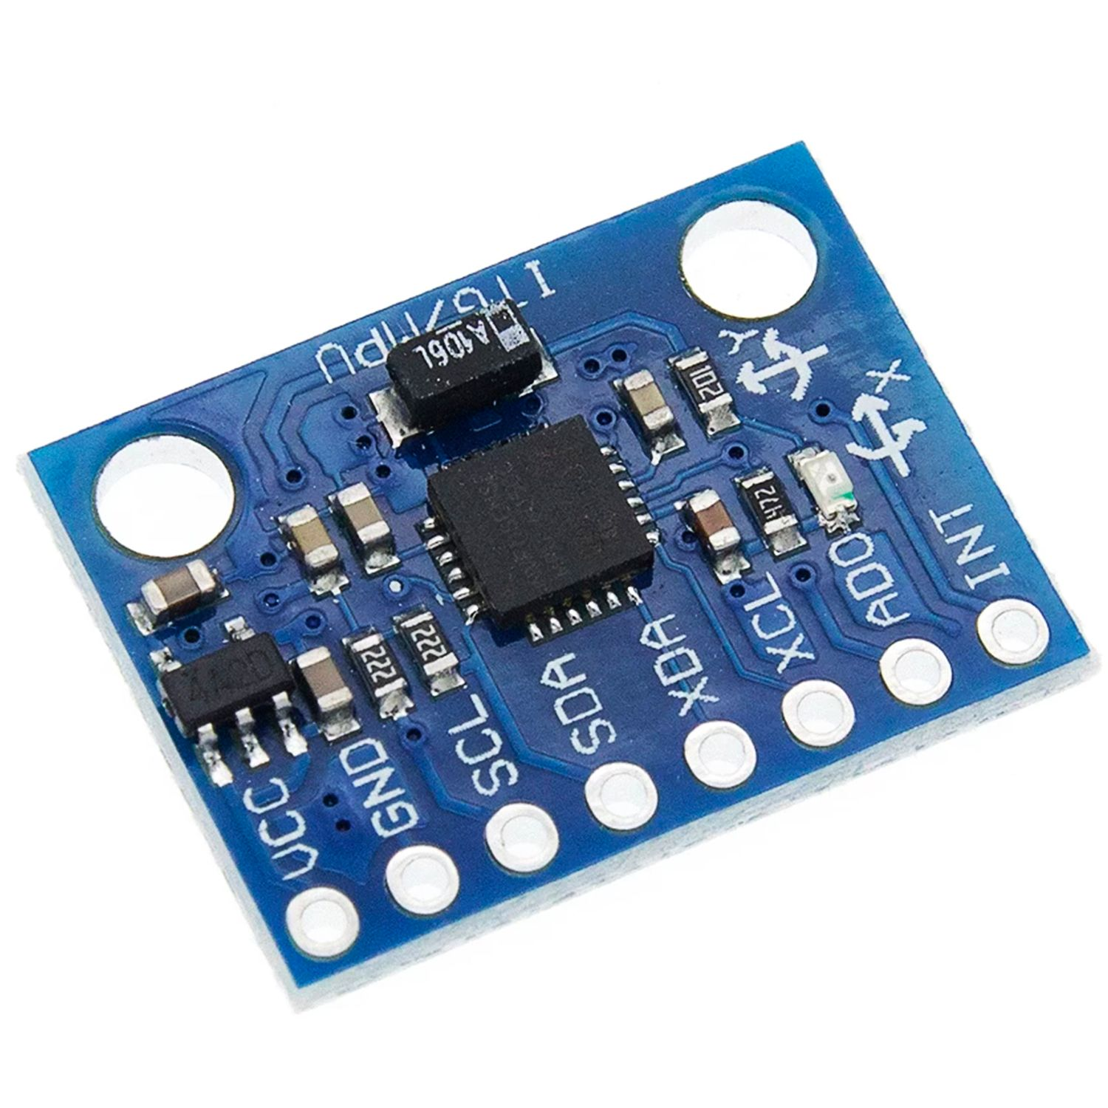
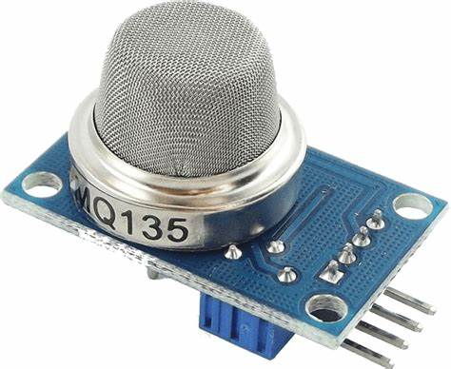
Sensors
3-axis gyroscope MPU-6050:
Used to detect the movement direction and magnitude
I2C Interface
Low-cost
Easy to get up and running and capturing the raw data output of the device
CO2 sensor Mq135:
Used to detect the presence of flammable gases
Marketed as a generalized “air quality” sensor, capable of measuring the concentrations of several gases, one of which is CO2
Low-cost alternative to more specialized (and more expensive) CO2-specific sensors

Slide 30
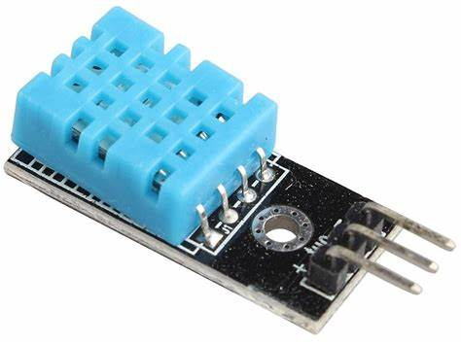
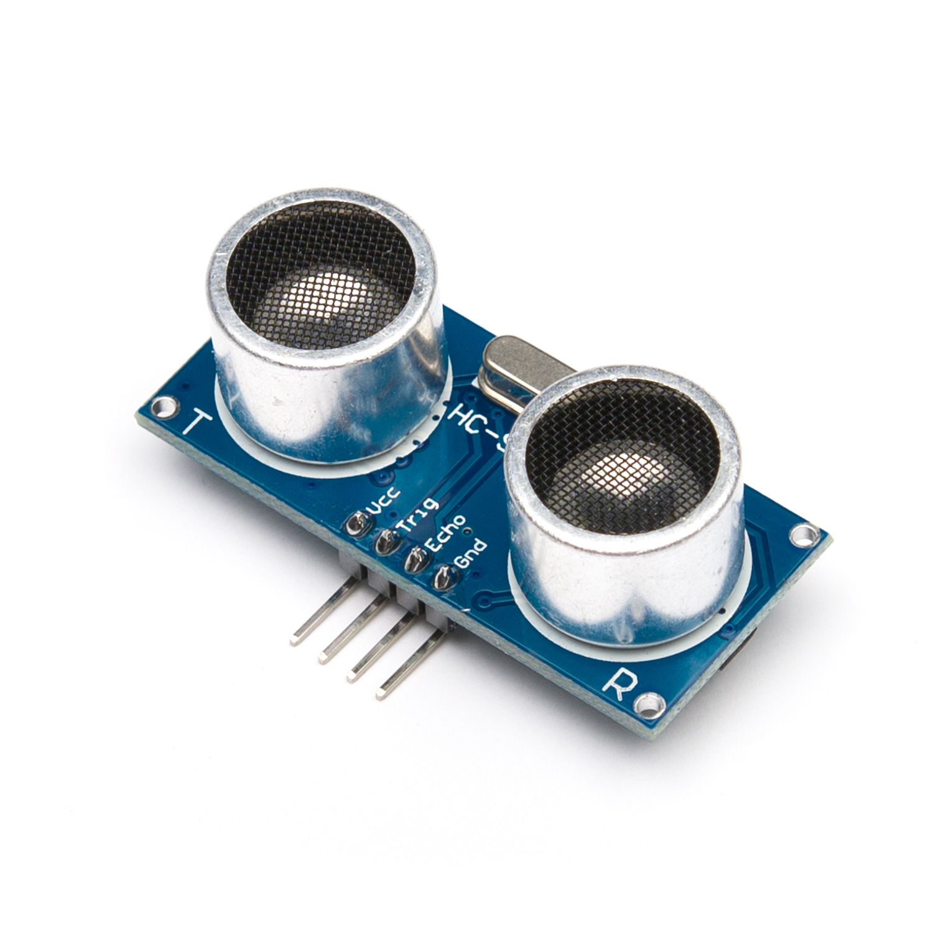
Sensors
Temperature and humidity sensor DHT11:
Output: Serial data
Temperature Range: 0°C to 50°C
Humidity Range: 20% to 90%
Accuracy: ±1°C and ±1%
Easy to interface with other microcontrollers
Ultrasonic sensor HC SR04:
Minimum measurable distance 2cm
Maximum distance measurable 400cm
Resolution: 3 mm
Simple method for measuring distances, where high precision combined with a high measuring range is required

Slide 31
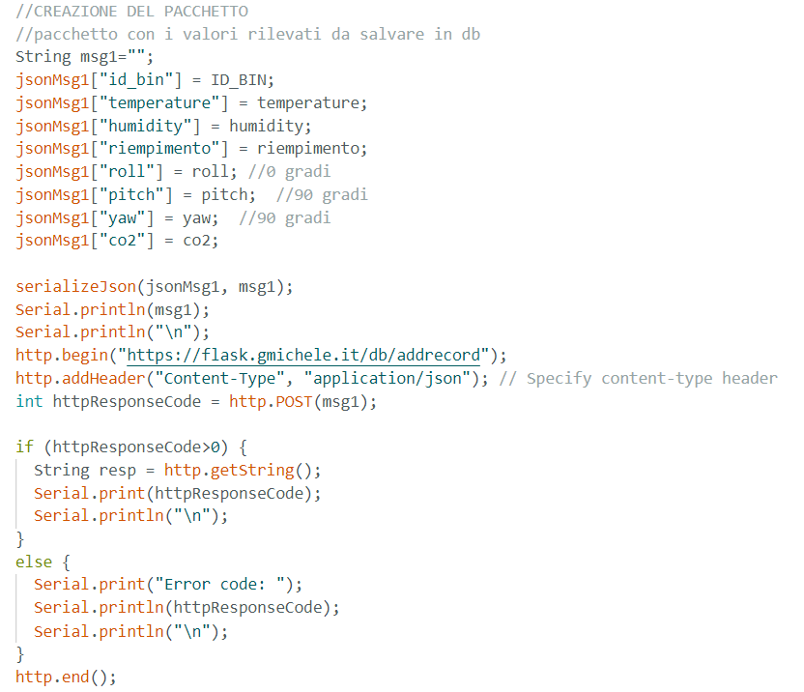
Sensors: package

Slide 32
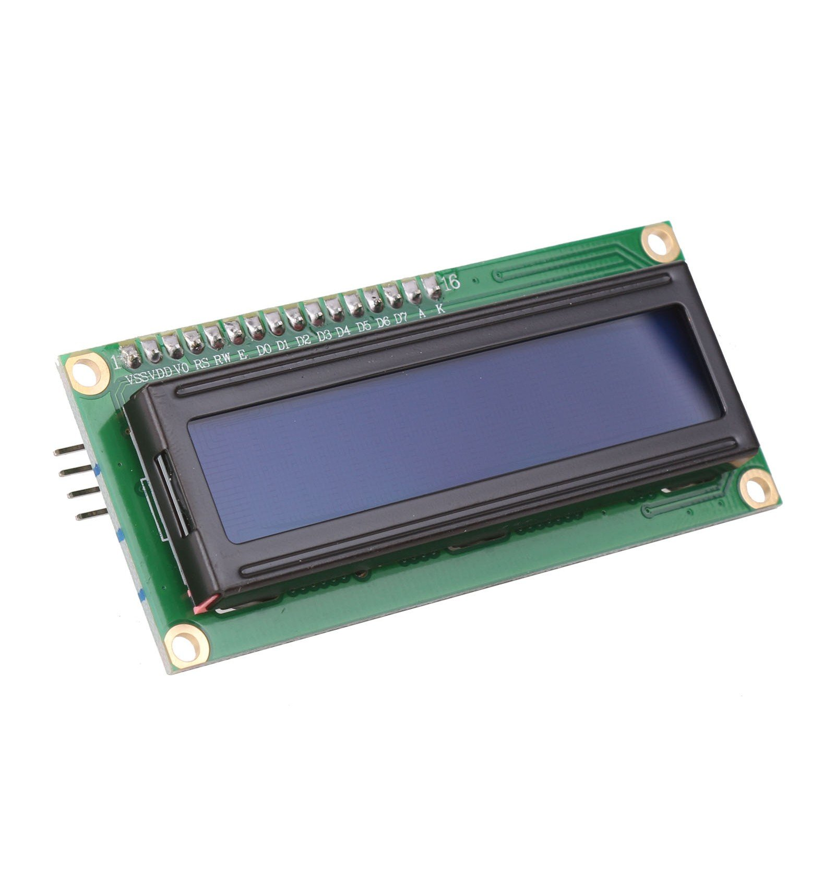
Actuators
Card Reader RFID RC-522 :
It is normally used in application where certain person/object has to be identified with a unique ID.
Communication : SPI, I2C protocol, UART (SPI is often used since it is the faster)
The module can be easily used with Arduino because of its readily available RC522 RFID Arduino library
RF Module consists of a RFID reader, RFID card and a key chain
16x2 I2C LCD display:
It allows you to display up to 32 characters at a time, arranged in 2 lines of 16 characters each
the integrated I2C communication interface makes it extremely easy to use with Arduino

Slide 33
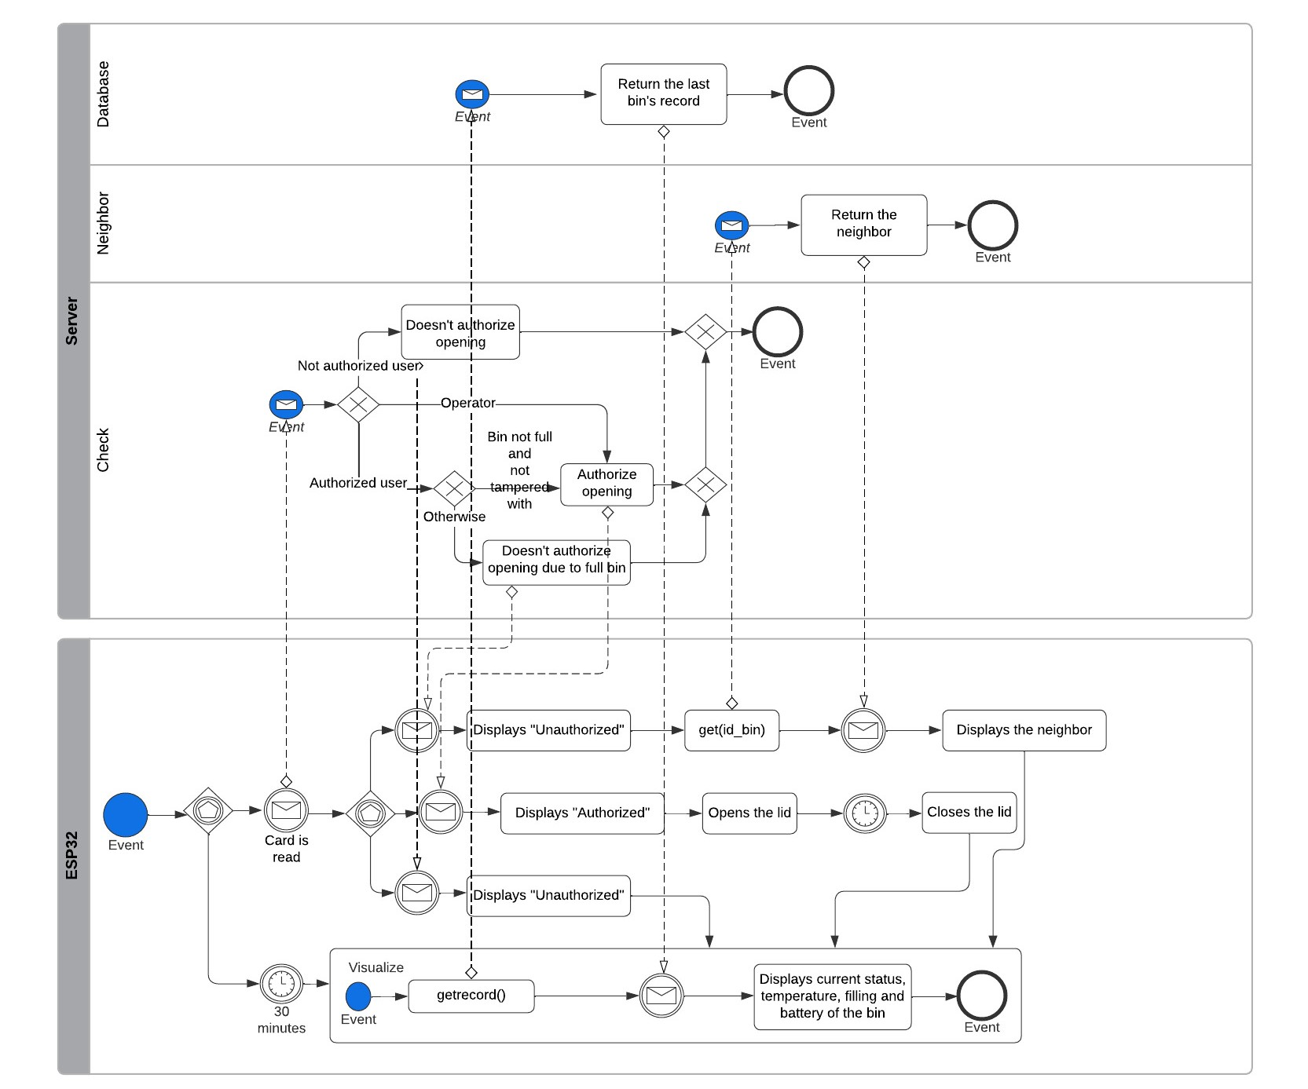
Actuators

Slide 34
Demo

